Slide 1
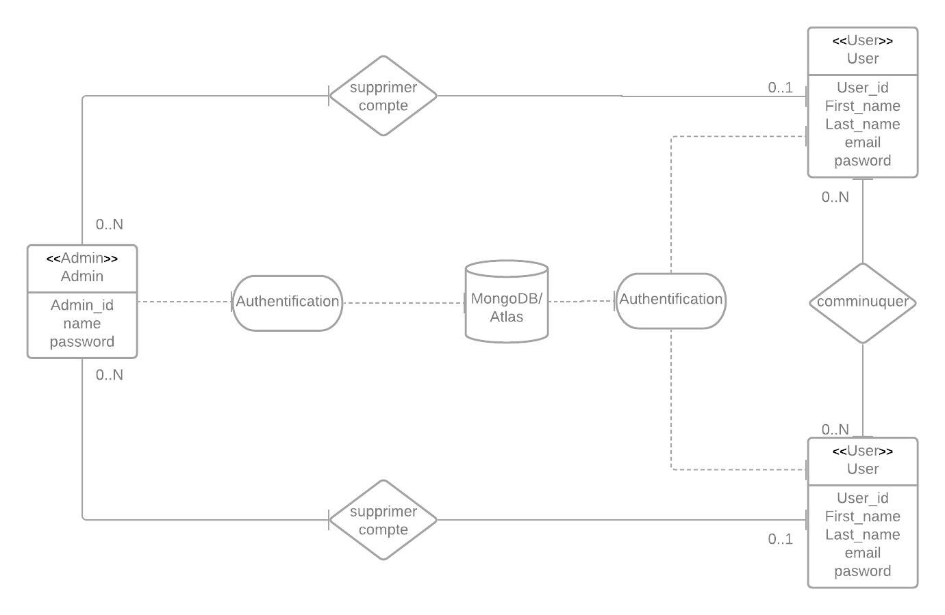
Diagramme de classe:

Slide 2
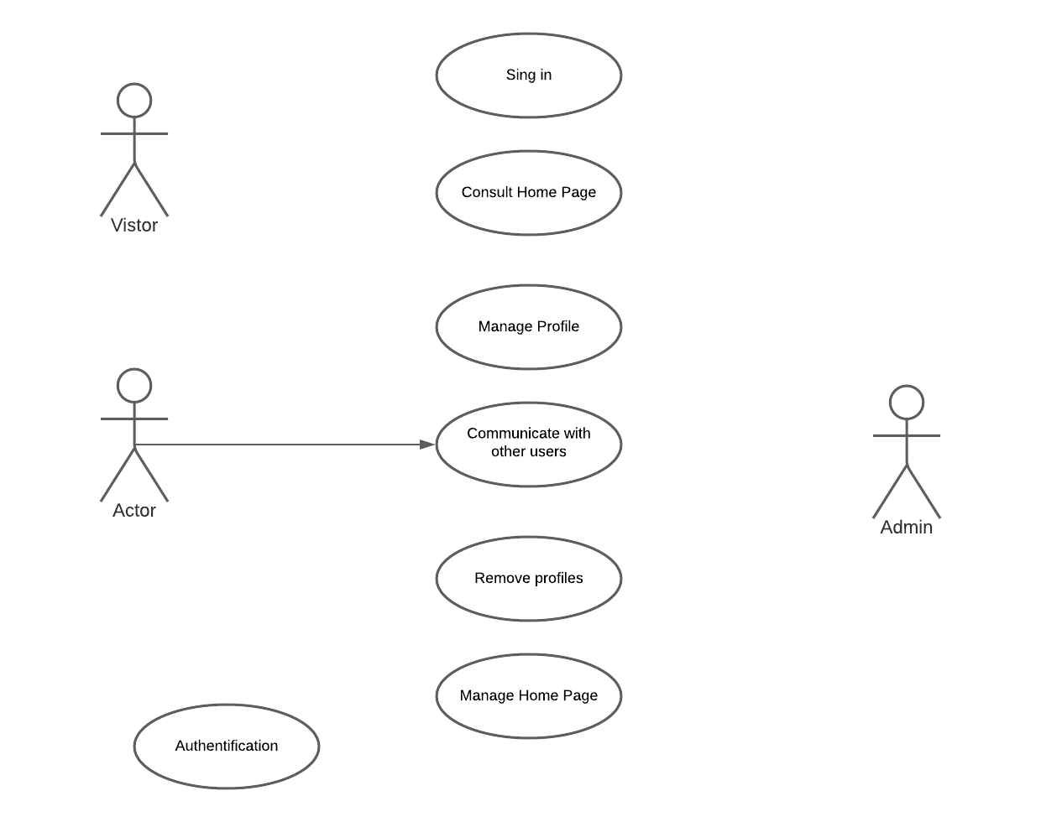
User
<include>
<include>
<include>
<include>

Slide 3
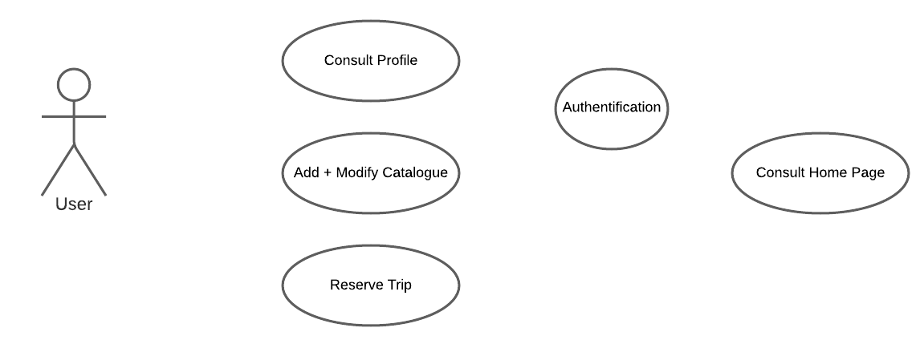

Slide 4
Home page
NAVBAR
Logo+Nom
Top destinations
Top agences
Croisières
Sidebar
Images de qlq destinations
Login
Dropdown
Destination ……
Rating……
rechercher
Signin
image
image
image
Contact us
Rating
Rating
Rating
Description
Description
Description
Top 10 Destinations
Top agences
Qui sommes nous?
footer

Slide 5
Sign in
First Name *
Last Name *
First Name…
Last Name…
Email address *
Password *
email…
password…
Confirm password *
Confirm password…
Sign in
cancel

Slide 6
Sign in
Email address *
email…
Password *
password…
Forgetten password?
Login
cancel

Slide 7
Contact us
NAVBAR
Logo+Nom
Top destinations
Top agences
Croisières
Sidebar
Welcome to our app , …………………………………………………………………………………..
Login
Name
Name…
Signin
Email
Contact us
email…
Subject
Write something…
Message
send

Slide 8

NAVBAR
User Account
search……
rechercher
Calendar
Next Trip
image
image
image
Full Name User
Log out
Description
Description
Description
image
Description
Message
Sidebar

Slide 9


Site Administrator
Remove User
Manage Destination

Slide 10
Site Administrator
AUTHENTIFICATION
Users
Remove User
MANAGE SITE
Destination
Add
Remove

